Slide 1
DJANGO - Building Web Applications

Slide 2

What is Django?
High-Level Python Framework.
Developed for faster development.
Built-in features.
WHY USE Django?
Rapid Development.
Secure by Default.
Scalable and Versatile.

Slide 3

MVT Architectural Pattern
Model
Data layer of the application
View
Business logic layer of the application
Template
Presentation layer of the application

Slide 4
Built-in Security Features
Django Authentication
Ease of Use and Customization
Scalability and Flexibility
Ready-to-use views and forms for common tasks
Easily integrated with third-party authentication
Built-in security mechanisms to protect user data
Prevent common vulnerabilities
Scale with your application
Adapt to different use cases

Slide 5
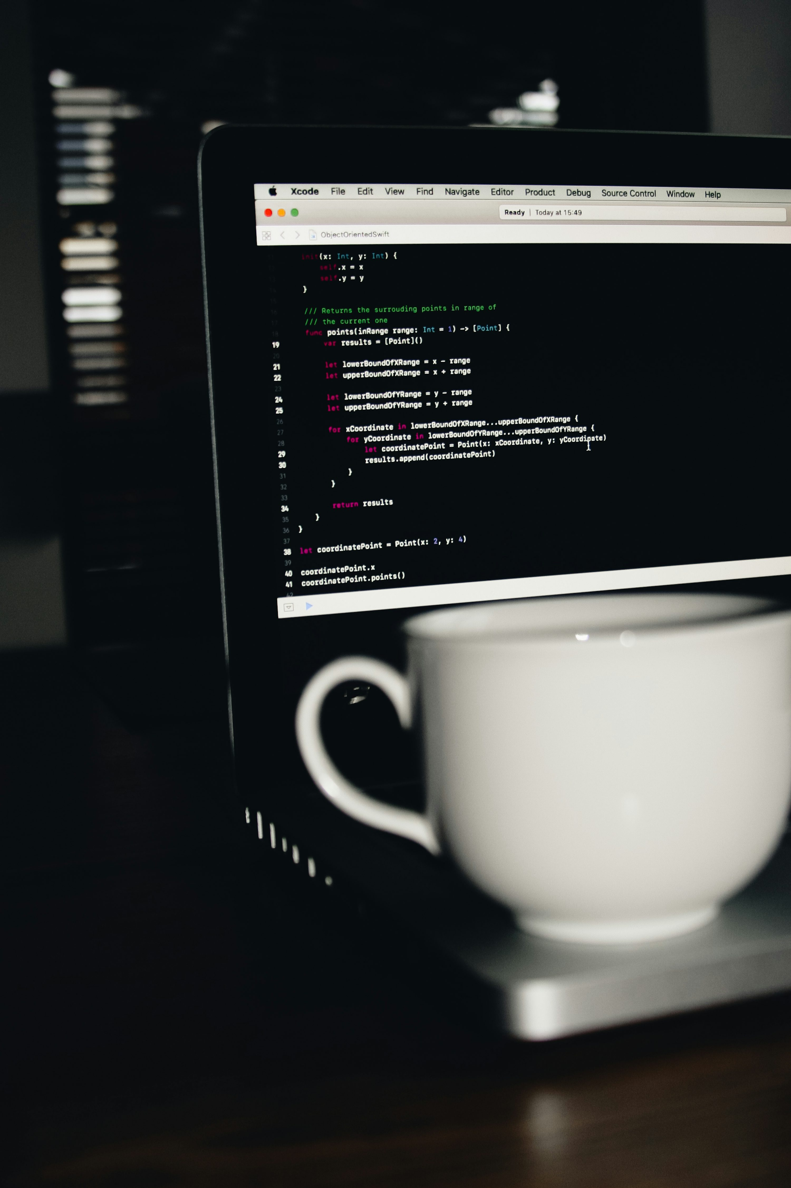
Prerequisites to Learn Django
Python Programming
Basic Web Development
Database & SQL
5

Slide 6

Setting Up Django
Installation
Install Python and pip.
Install Django: pip install django
Creating a Django Project
Command: django-admin startproject myproject
Running the Development Server
Command: python manage.py runserver
Access the server at http://127.0.0.1:8000/

Slide 7
File Structure
settings.py
Contains all project settings and configurations.
urls.py
Maps URLs to views for handling requests.
wsgi.py
Configures the project for WSGI-based deployment.
manage.py
Command-line utility for managing the project.
apps.py
Contains app-specific configuration.
models.py
Defines database models.
views.py
Handles business logic and HTTP responses.
forms.py
Defines forms for user input.

Slide 8
Conclusion & Next steps
Master Django Basics: Practice setting up projects working with models, views, and templates.
Build Real-World Applications: Apply your knowledge by creating dynamic web applications.
Explore Advanced Topics: Learn Django REST framework, deployment, and security best practices.
8

Slide 9
THANK YOU
Siddhant Mishra
siddhant.mishra0307@gmail.com
https://www.linkedin.com/in/siddhant-mishra-021726181/

